Slide 1
Radial Velocity Follow-up of exoplanet candidates from gaia dr3
By: Avidaan Srivastava
Advisors: Prof. François Bouchy, Angelica Psaridi

Slide 2
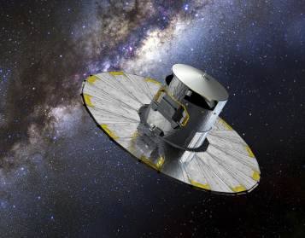
What is GAIA?
ESA mission to 3D map the entire sky
Launched in 2013
4 sets of data released:
DR1 (2016)
DR2 (2018)
EDR3 (2020)
DR3 (2022)
RV, TRANSIT, ASTROMETRY exoplanet candidates
Photo credit: ESA
Notes:
GAIA is in L2 point around the Sun
Successor to Hipparcos
Photo credit: ESA

Slide 3
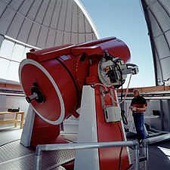
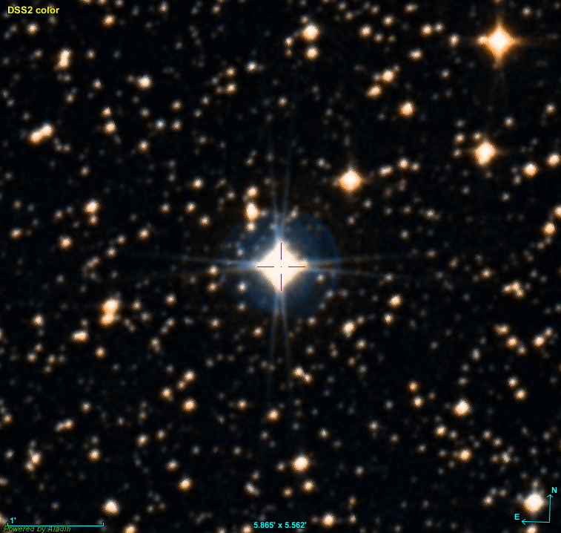
RV Follow Ups
Ground observations via 1.2-m Swiss Euler Telescope
using the CORALIE spectrograph
New 709 program
Targets are tracked over the course of several nights
Exposure time depends on V-mag of star
Finding charts using ALADIN to help locate dimmer stars
DACE platform used to access data and model RV
Photo credit: ESO
Notes:
CORALIE located in Chile
Exposure: 15 mins – bright; 30 mins – faint or 30 if you need more accurate data points
Photo credit: ESO

Slide 4
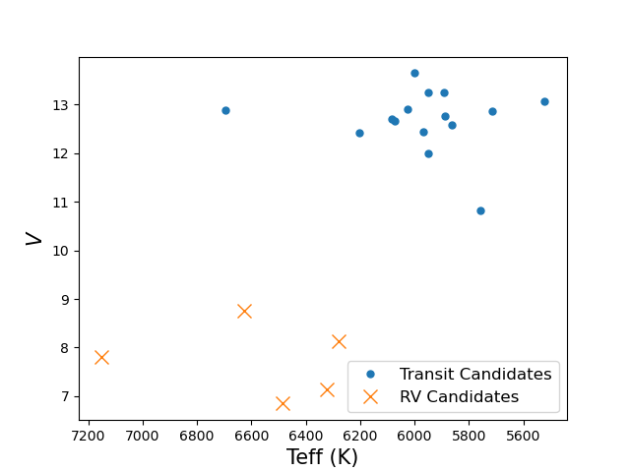
Target Selection
39 Transiting Candidates (TROIs); 8 RV Candidates (RVOIs)
Criteria for selection:
Visible from La Silla site in Chile (estimated using STARALT)
V< 13.5 mag
TROIs stars: Airmass < 1.5
RVOIs stars: Airmass < 2
Discard Confirmed Binaries
In the end, 15 TROIs and 5 RVOIs shortlisted - some still need to be followed-up!
Notes:
Staralt is a software where you can put in the coordinates and the date and time when you want to do the observation and it’ll show you the airmass, time of visibility, etc
Confirmed binary – from WASP (it knew TESS would detect it as a false positive)
Mostly bright stars (F-type…1 A-type). RV stars are more bright

Slide 5
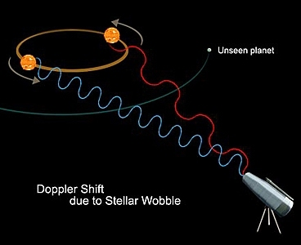
RVOIs
GAIA Archive (G_{mag} , T_{eff} , Period)
Derived (Luminosity, Mass, Radius)
Velocity Semi-Amplitude estimates from ‘exoplanet.eu’
No lightcurves
Photo credit: NASA
Notes:
Compare semi-amplitude and period to the observations from CORALIE
Photo credit: NASA

Slide 6
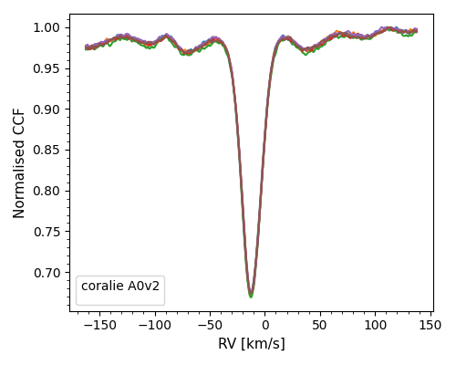
CORALIE Data (CCF)
CORALIE records target’s Cross Correlation Function (CCF)
Single Peak per star
Wide CCF – fast rotator
Notes:
Q: Why are CCFs not normalized? Don’t know, CORALIE sent them this way
Write what CCF is

Slide 7
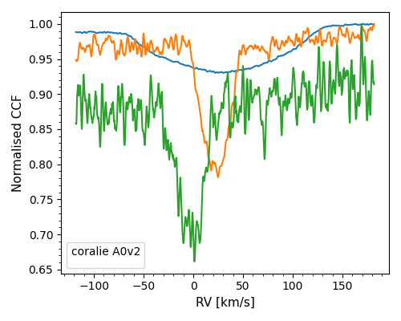
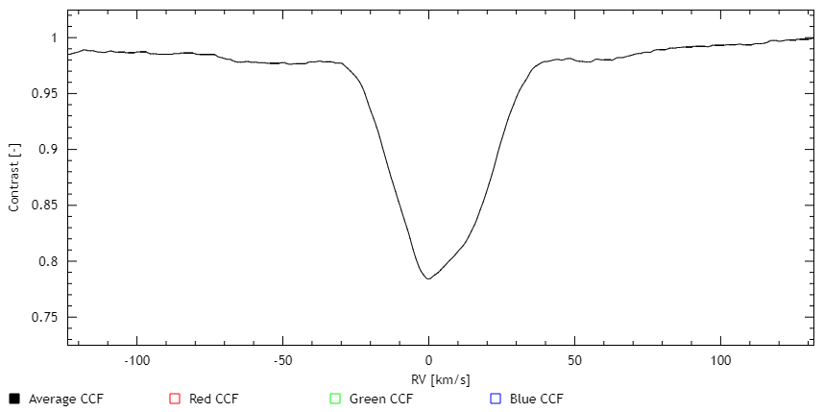
CORALIE Data (CCF)
Asymmetric CCF Evidence of Spectroscopic Binary!
Overlay CCF from each point to check for consistency Here – Different targets!
Notes:
Q: Why are CCFs not normalized? Don’t know, CORALIE sent them this way
Write what CCF is

Slide 8
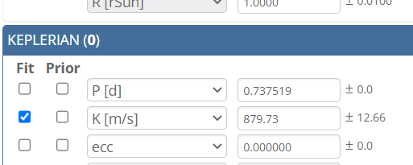
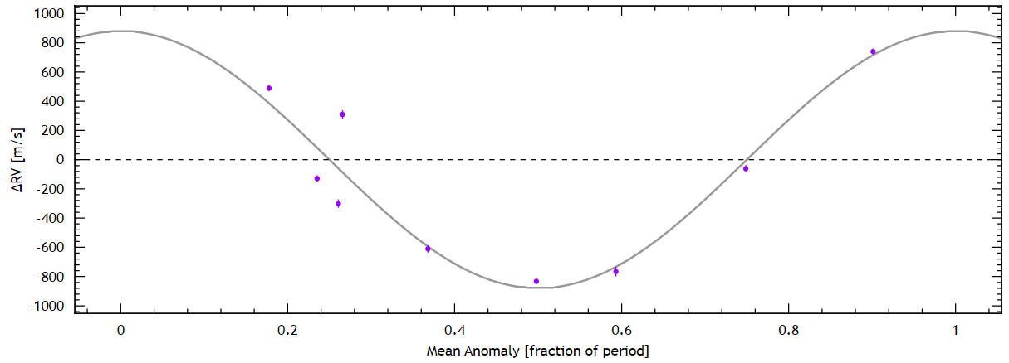
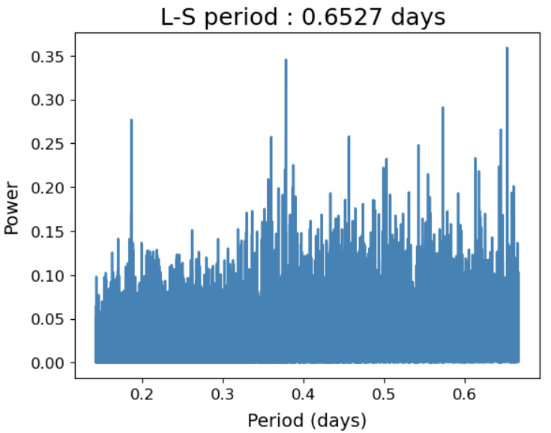
RVOI-008
RV (m/s)
Phase
GAIA reported period = 0.65 days
Notes:
Replace ss with table

Slide 9
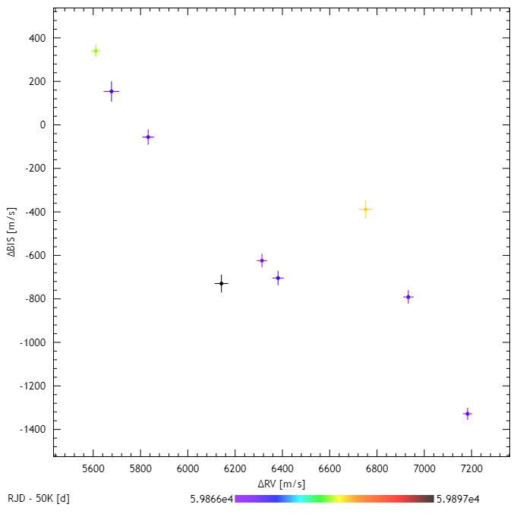
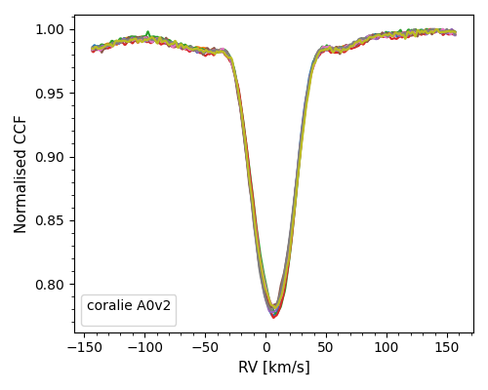
RVOI 008 (cont.)
Looked to be promising planetary candidate
Good RV fit
Symmetric CCF
- Planet mass corresponding to 4.5 M_{jup}
BUT! Clear correlation in CCF Bisectors
We need more data points to explain this
Notes:
Bisector explain – make graph labels more visible

Slide 10
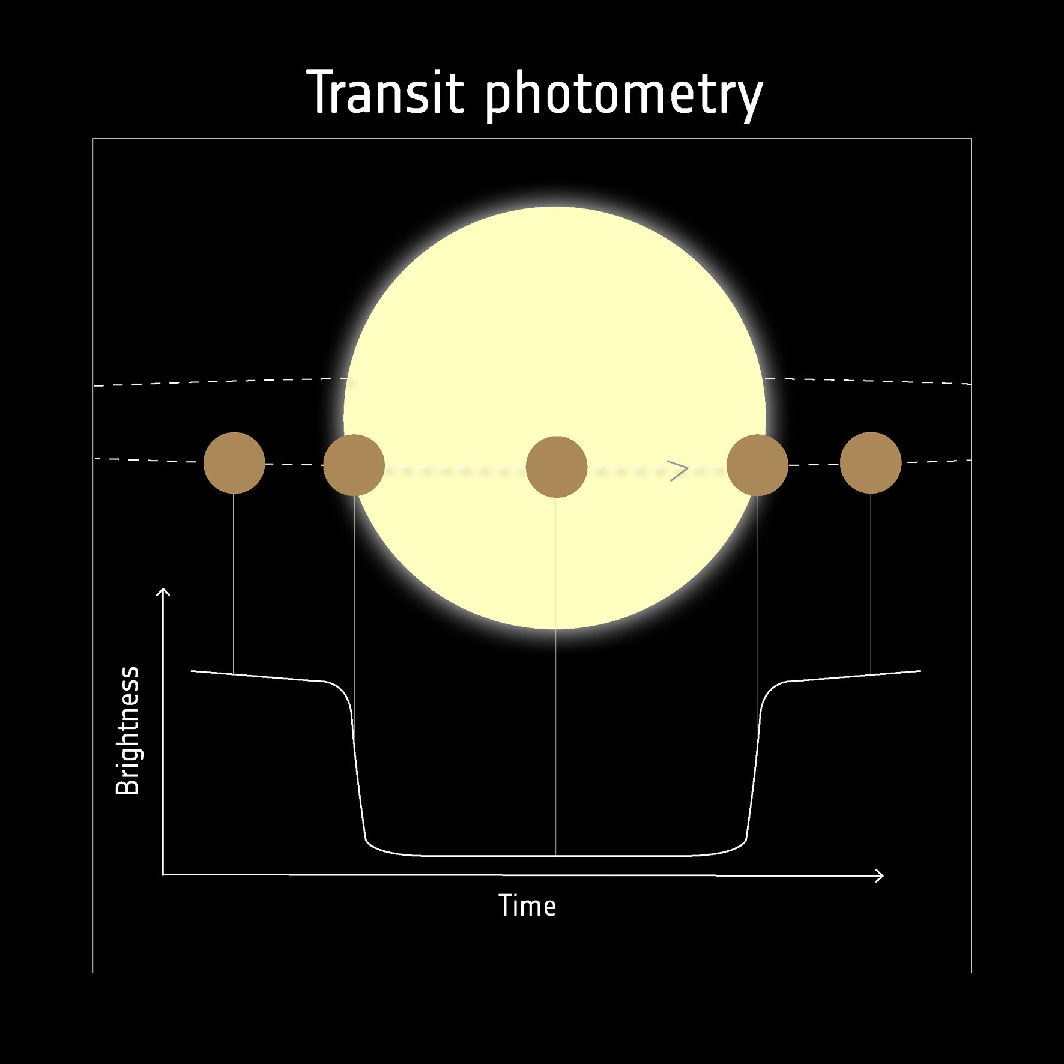
TROIs
Info extracted from GAIA Archive and used to derive parameters (Period, Mass, Radius)
TESS (30-min cadence) lightcurves for few targets! (11/15 TROIs)
Transit depths (look for ‘Odd/Even’ transits, shape of transit)
Period (BLS Periodogram)
Radius of Planet (BATMAN - MCMC sampling)
Compare results to GAIA (ephemeris and transit depth)
Photo credit: ESA
Notes:
Talk about TESS (what it is and what are the lightcurves) + low cadence
Ephemris = Epoch time + Period
Photo credit: ESA
TROI - 012

Slide 11
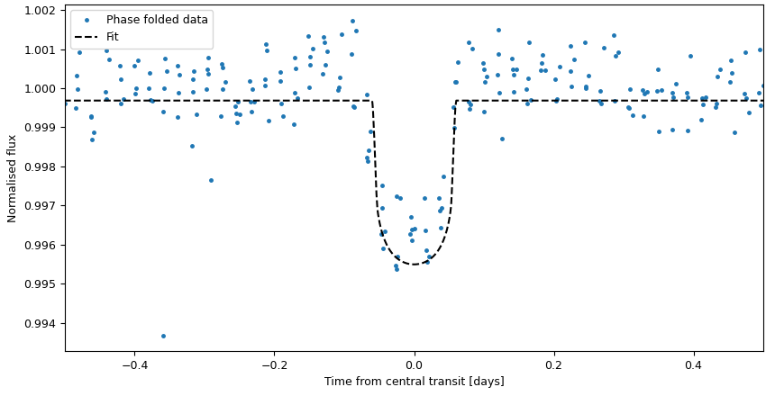
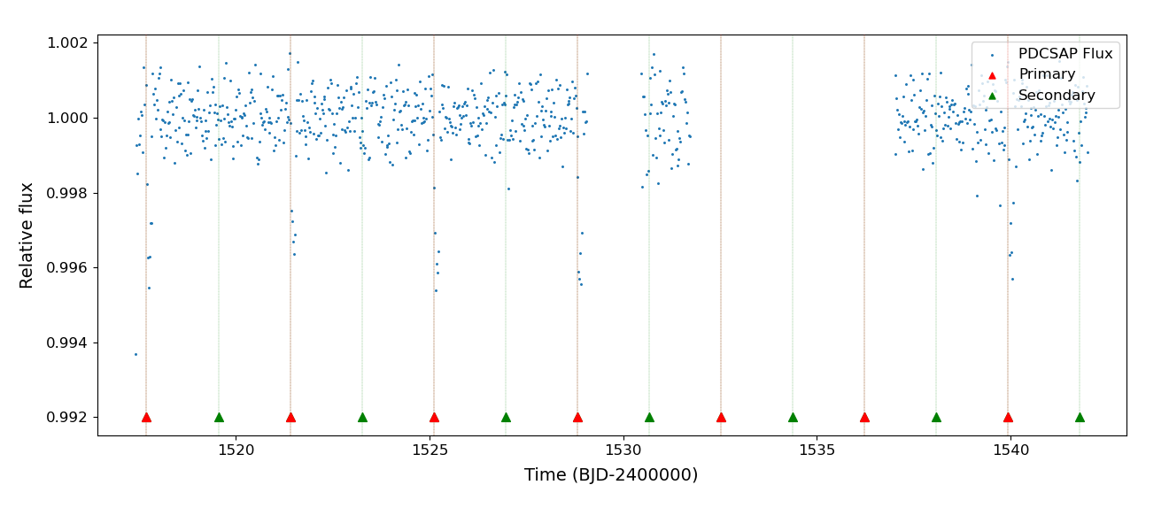
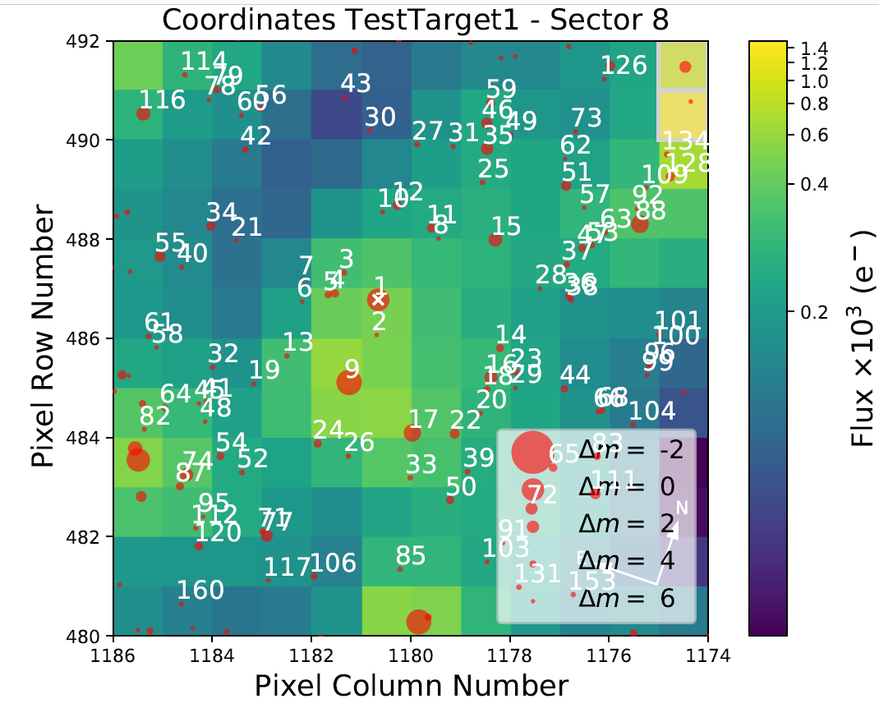

TROI-005
Transit Depth:
TESS Lightcurve = 4.021 mmag
GAIA Reported = 15.023 mmag
GAIA
TESS
Photo credit: GameTunes
Notes:
PSF size of TESS = 1 arcmin – less resolution
Question: How does TESS know the transit – it doesn’t so we discarded this target later on

Slide 12
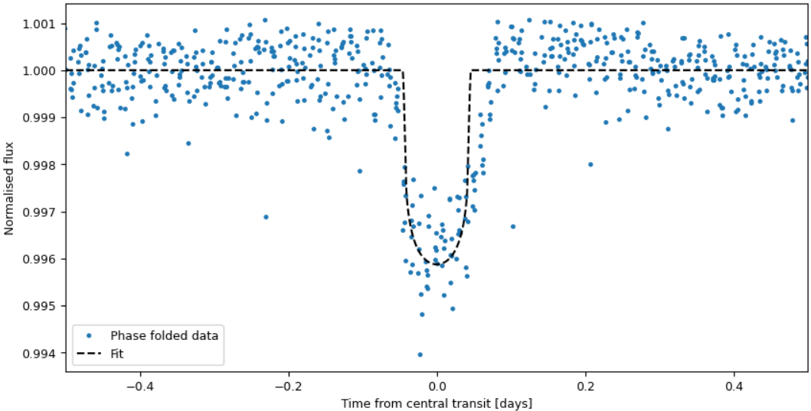
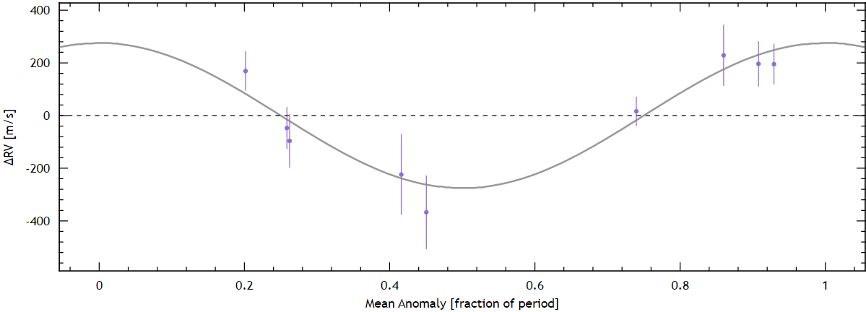
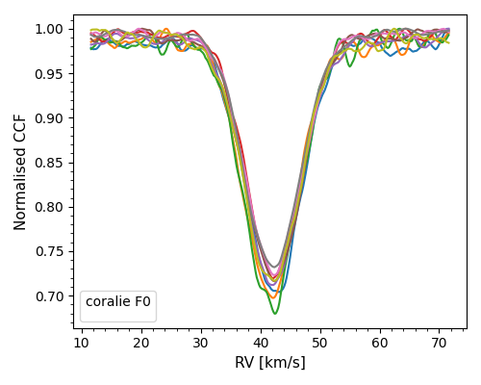
TROI-013
RV (m/s)
Phase
Consistent with Planet of mass = 1.89 M_{jup}
(Using GAIA ephemeris)
Notes:
GAIA Period and Epoch (ephemeris) used to get the RV fit
CCF is a little asymmetric (variability of star/error) – no correlation in bisectors

Slide 13
Final Results
7 total targets have been observed (16 total nights of observation)
2 confirmed Spectroscopic Binaries, 2 false positives
More follow-ups (December - March)
Still many targets to go!
QUESTIONS?

